Slide 1

Water Supply
Civil Engineering and Architecture
© 2010 Project Lead The Way, Inc.

Slide 2
TABLE OF CONTENTS
Why Treat Water?
Uses of Water
Water Supply System
Sources of Water
Water Treatment
Water Storage
Distribution System
Definitions
Calculating Water Supply Pressure

Slide 3
Why Treat Water?
Society realized long ago that human health and the welfare of the general population are improved if public water supplies are treated prior to use.
Nearly all structures require a water supply.
Appropriate flow rate, pressure, and water quality are necessary for effective use.

Slide 4

Uses of Water
Bathing
Toilets
Cleaning
Food preparation
Cooling
Fire protection
Industrial purposes
Drinking water = Potable water
©iStockphoto.com
Notes:
Today, almost all commercial, industrial, or residential structures must have a water supply. Water is also used for such things as bathing, toilets, cleaning, food preparation, cooling, fire protection, and industrial processes.

Slide 5
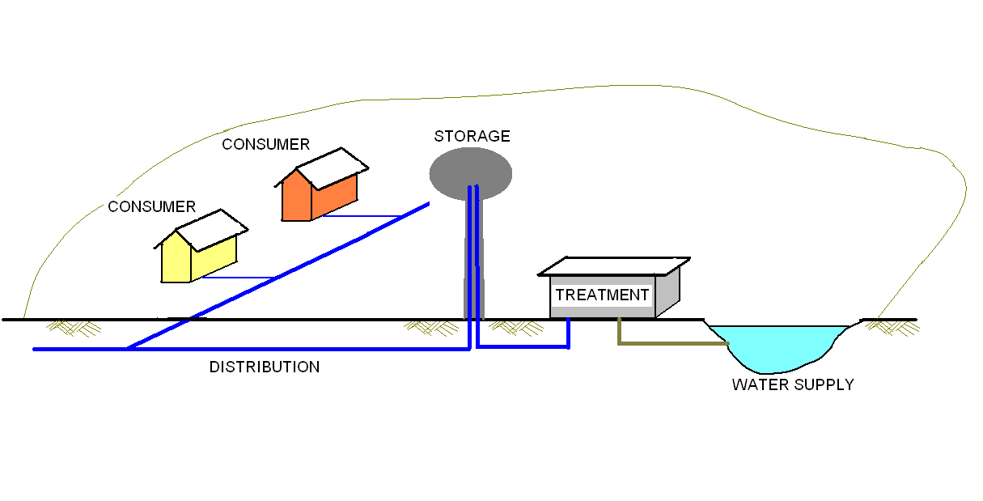
Water Supply System
Notes:
Some civil engineers are responsible for designing systems that provide a reliable and clean water supply.
A water supply system begins at a water source.
Water is transported to a treatment facility where the water is treated to ensure the supply is safe.
Once treated, the water is transported to a storage facility (for example, a water tower) where it is stored for future demand.
When a water faucet is opened or a fire sprinkler is activated, water is transported through the distribution system to the consumer.

Slide 6
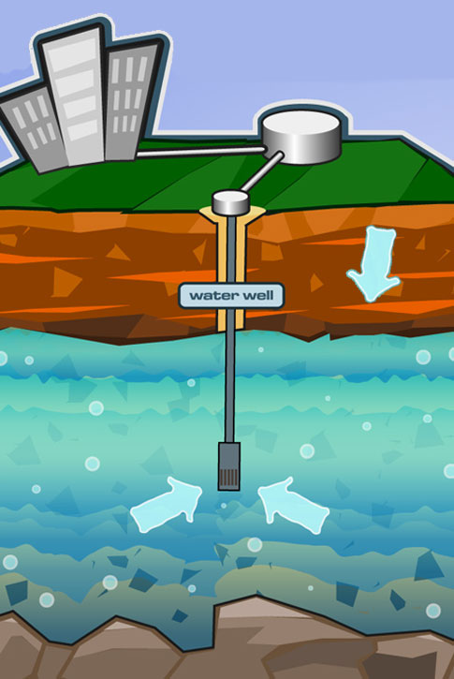
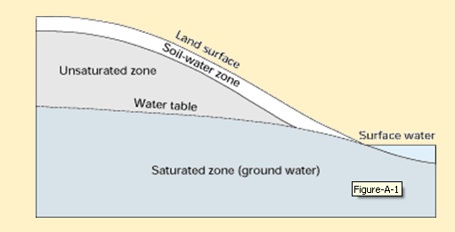
Sources of Water
Aquifers (Groundwater)
  Primary source of drinking water
  Porous consolidated rock or unconsolidated soil
  Groundwater fills spaces
  Wells and pumps used to remove water
Aquifer
This image was reproduced from groundwater.org with the permission of The Groundwater Foundation. © 2010 The Groundwater Foundation. All Rights Reserved
Courtesy USGS at http://pubs.usgs.gov/circ/circ1139/htdocs/boxa.htm

Slide 7


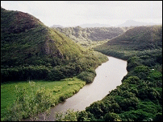
Sources of Water
Surface Water
  Lakes, reservoirs, rivers
  Rivers dammed to create reservoirs
  Reservoirs store water during heavy rain/snow
Courtesy USDA http://www.ks.nrcs.usda.gov/news/highlights/2006_april.html
©iStockphoto.com
Courtesy NASA http://www.ghcc.msfc.nasa.gov/surface_hydrology/water_management.html
Lake Tuscaloosa Dam

Slide 8
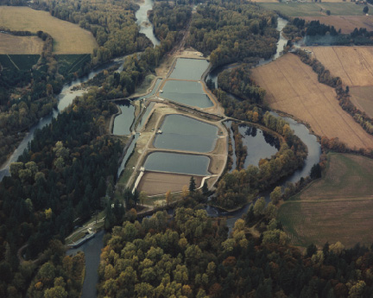
Water Treatment
Amount of treatment depends on quality of the source
Ground water requires less treatment than surface water
Courtesty USGS http://pubs.usgs.gov/fs/2004/3069/
The city of Salem water treatment facility withdraws water from the North Santiam River.
Notes:
The method of water treatment and the size of the plant are dependent on the quality of the water supply and the water demand. In general ground water requires less treatment than surface water because surface water is exposed to more contaminants. Water from some private well sources may require no treatment.

Slide 9
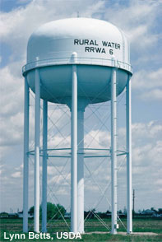
Water Storage
Pumped to Storage Tank
  Storage
  Water pressure
    psi
    1 psi = 2.31 feet of water
NOAA http://www.csc.noaa.gov/alternatives/infrastructure.html
Notes:
Treated water is pumped to a storage tank. Storage tanks are often elevated. A storage tank serves two purposes.
It stores the water until it is needed, which reduces the peak demand on the treatment facility.
Elevated water tanks create pressure in the water distribution system.

Slide 10
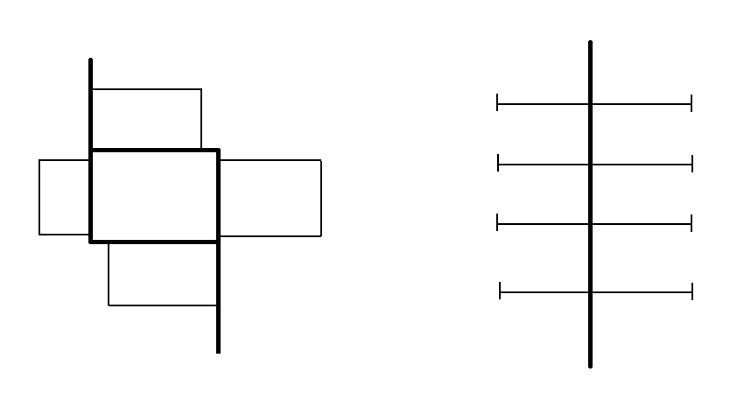
Water Distribution System
Consists of water lines, fittings, valves, service lines, meters, and fire hydrants
Loop system more desirable than branch system
  Isolation valves
  Water flows in more than one direction
LOOP SYSTEM
BRANCH
SYSTEM
Notes:
The water distribution system includes all of the water lines and components attached to the water lines.
There are basically two different distribution system configurations: Loop systems and branch systems.
Loop systems are more desirable because they provide redundancy. If a leak occurs in a loop system, installed isolation valves can be used to close off a small area near the leak but allow the remainder of the system to continue to provide water. In a branch system, the entire system must be shut down to repair a leak.
In addition, the loop system allows water to flow from more than one direction which can reduce the negative effect felt in a branch system when upstream demand reduces pressure and flow rate.

Slide 11
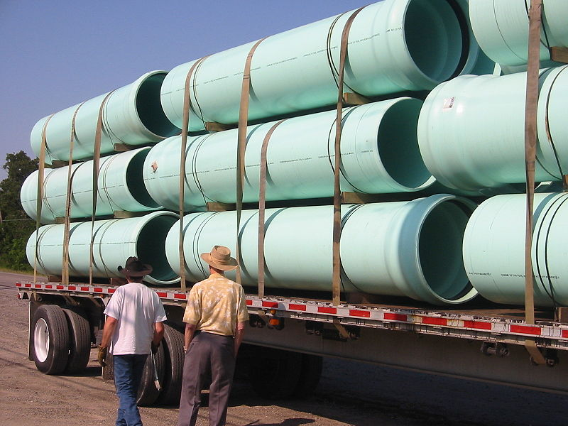
Water Distribution System
Typical new system pipe
  Thermoplastic or ductile iron
  Reinforced concrete in larger mains
Older system pipe
  Cast-iron or asbestos cement
Typical distribution pressure of 65 – 75 psi
Designed for less than 150 psi
wikimedia
Notes:
New systems are often constructed with thermoplastic or ductile iron piping. Because the efficiency of the system depends on a smooth interior pipe surface, cement linings or coatings are sometimes used to reduce the pitting and corrosion associated with iron pipes. For larger diameter water mains, reinforced concrete pipe is often used.
Cast-iron pipe and asbestos cement pipe have been a popular choice for water distribution systems in the past, so you may encounter these materials when tying into older existing systems.
A distribution system pressure of 65 – 75 psi is often recommended. Pressures over 150 psi can cause leaks and damage to the system.

Slide 12

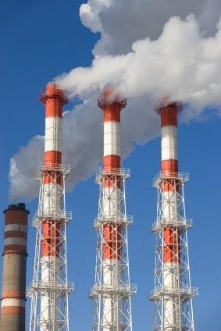
Consumer
Residential, commercial, and industrial facilities
Residential
  Min. distribution pressure = 40 psi
  Max. distribution pressure = 80 psi
    Pressure-reducing valve
Commercial or industrial facilities
  May require higher pressure
  Pumps can increase pressure
©iStockphoto.com
©iStockphoto.com
Notes:
The water supply system must adequately serve all customers including residential, commercial, and industrial facilities. The water pressure, flow rate, and demand times may vary significantly among users.
For residential consumers, the minimum desirable distribution pressure is 40 psi. A pressure over 60 psi is considered high. Because it increases the flow rate, high water pressure can lead to increased water use (waste) and increased energy use (due to heating the excess water). In addition, high water pressure can damage appliances and fixtures and cause them to wear out more quickly. Codes often require pressure-reducing valves at the service meter when the distribution pressures exceed 80 psi.

Slide 13
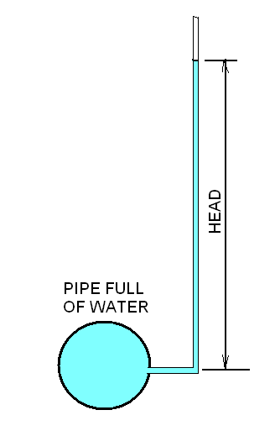
Definition
Head
  Relates energy in an incompressible fluid (like water) to the height of an equivalent column of that fluid
Notes:
In fluid dynamics, head can be measured by the height to which water rises in a column when directly open to the water.

Slide 14
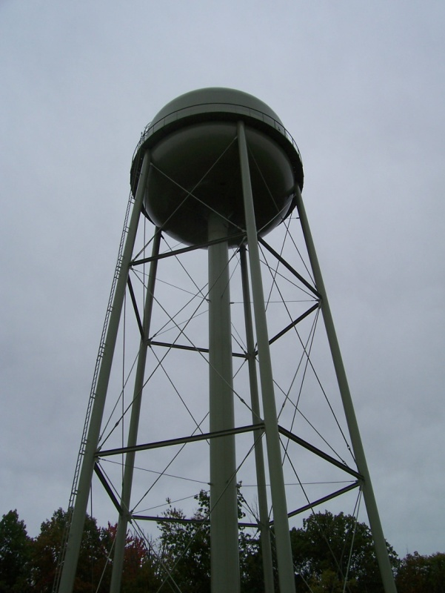
Definition
Static Head
  Potential energy of the water at rest
  Measured in feet of water
  Change in elevation between source and discharge
  Ex: What is the static head at a residential supply line if the water level in the elevated tank is 943 ft and the elevation at the supply line is 890 ft?
    943 ft – 890 ft = 53 feet of water
EPA at http://www.epa.gov/region02/superfund/npl/mohonkroad/images.html
Notes:
[After animating the example, ask students to calculate the static head before clicking to show the calculation.]

Slide 15
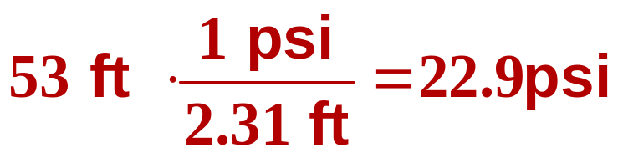
Definition
Static Pressure
  Pressure of water at rest
  Measured in pounds per square inch (psi)
  2.31 feet of water = 1 psi
  Ex: What is the static pressure at distribution if the static head is 53 ft of water?
  Is this the pressure at which water would exit a faucet in the house?
Notes:
[After animating the example, ask students to calculate the static head before clicking to show the calculation.] (click)
(Click) Is this the pressure at which water would exit a faucet in a house? NO! [go to next slide]

Slide 16
Water Pressure Calculations
How far above the supply line must the water level in a water tower be in order to provide a minimum 40 psi?
Except water loses pressure as it travels through pipe.
NOAA http://www.csc.noaa.gov/alternatives/infrastructure.html
Notes:
In order to provide a minimum of 40 psi pressure, the water level in the tank must be 92.2 feet above the supply elevation. However, 40 psi static pressure at the supply does not guarantee a water pressure of 40 psi when you turn on a faucet or flush a toilet.
Water loses pressure as it travels through pipe, so the actual pressure felt at the point of use is less than the static pressure.

Slide 17
Definitions
Head Loss
  Energy loss due to friction as water moves through the distribution system
    Pipes
    Fittings
      Elbows, tees, reducers, etc.
    Equipment (pumps, etc.)
  Major losses = head loss associated with friction per length of pipe
  Minor losses = head loss associated with bends, fittings, valves, etc.

Slide 18
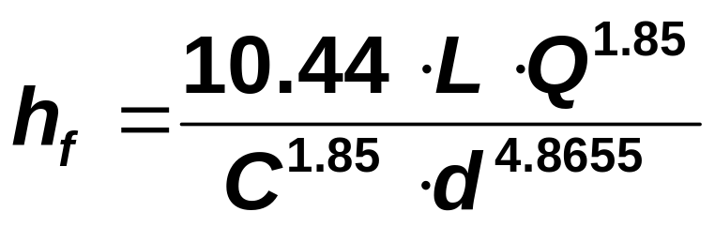
Calculating Head Loss
  Hazen-Williams formula
Where: h_{f} = head loss due to friction (ft)
L = length of pipe (ft)
Q = flow rate of water (gpm)
C = Hazen-Williams constant
d = diameter of the pipe (in.)
Notes:
Several methods can be used to estimate head loss in a system. We will use the Hazen-Williams method and equivalent length approach.
To calculate the head loss in straight pipe, use the Hazen-Williams formula. Be careful to use correct units when substituting values for the variables.
The value of the Hazen-Williams constant depends on the type and size of pipe and is taken from a chart of accepted values.

Slide 19
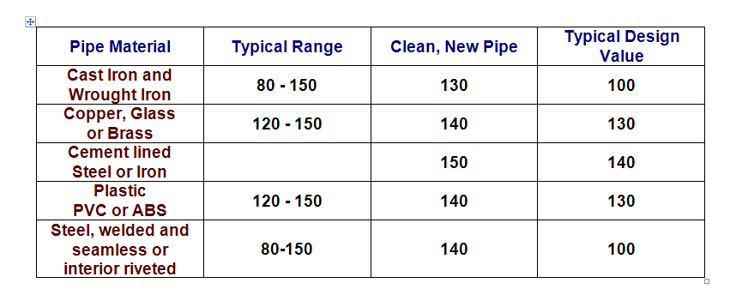
Hazen-Williams Constant, C
Notes:
Hazen-Williams constants depend on the type of pipe and the condition of the pipe.
Most pipe will experience pitting and corrosion with time. So as pipes age, the friction of the water against the interior surface of the pipe increases. Because the Hazen-Williams constant is in the denominator of the formula, a decrease in the constant will result in an increase in the frictional head loss. As you can see in the table, the constant used for design is less than the clean, new pipe constant. The design value assumes that the pipe has been in service for many years.
You can probably guess that steel and iron will deteriorate over time much more drastically than copper or plastic. This is indicated in the table by the difference between the clean and design constant values. The difference is much greater for steel and iron than for copper and plastic. Note that lining steel or iron pipes with cement will significantly reduce the increase in head loss over time.

Slide 20
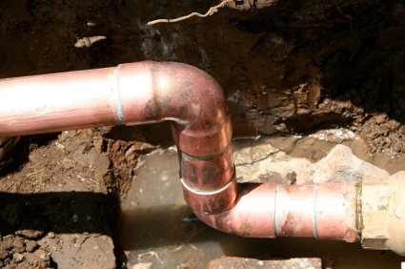
Calculating Head Loss
Minor Losses
  Hazen-Williams formula used for straight pipe
  Need equivalent length for each fitting to account for minor losses.
  Accepted equivalent length values published
©iStockphoto.com
Notes:
The Hazen-Williams formula considers only straight runs of pipe.
As you can imagine, when water has to make a turn or squeeze through a valve, it will lose energy. The Hazen-Williams formula does not directly account for minor losses due to fitting.
In order to use the Hazen-Williams formula to approximate head loss in a system with fittings, we must convert each fitting into an equivalent straight length of pipe.
In other words, we need to know the length of pipe that produces the same head loss that results when water flows through a fitting. For instance, a 90 degree elbow might produce a head loss that is equivalent to the head loss when water flows through 14 feet of straight pipe. Therefore, the equivalent length of the 90 degree elbow would be 14 feet. By adding the equivalent length of each fitting to the actual length of straight pipe, we obtain a “fictitious” total equivalent length that should yield the same head loss that results in the system.

Slide 21
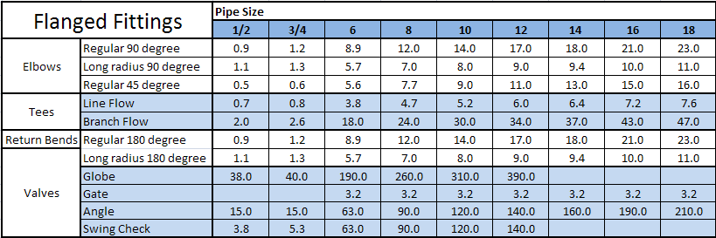
Equivalent Length in feet of pipe (Generic)
Notes:
The equivalent length of a pipe fitting depends on the size of pipe and the material of the fitting. However, not all fittings of the same size and material are equal – the equivalent length can vary between manufacturers. For preliminary calculations we will use a table of generic equivalent lengths that may be used for all materials and manufacturers.
For a 10 inch regular 45 degree elbow, the (generic) equivalent length is 9 feet. In other words, the head loss when water travels through a 10 in. diameter regular 45 degree elbow is equivalent to the head loss when water flows through 9 feet of straight 10 in. pipe.

Slide 22
Calculating Total Equivalent Length
Example
A 10 inch flanged cast iron water supply line provides service to a home. The pipe between the water tower and the meter includes seven regular 90 degree elbows, three line flow tees, eleven branch flow tees, and six gate valves between the water tower and a service connection to a residence. What is the equivalent length of the fittings and valves?
Fitting | Quantity | Equivalent Length (ft) | Total Equiv. Length (ft)
Reg. 90 deg elbow | 7 | 14.0 | 98.0
Line flow tee | 3 | 5.2 | 15.6
Branch flow tee | 11 | 30.0 | 330.0
Gate valve | 6 | 3.2 | 19.2
Total |  |  | 462.8

Slide 23
Calculating Head Loss
  Example
  What is the head loss in the 10 inch cast iron supply line with a flow rate of 110 gpm if the pipe is 3.2 miles long and includes the fittings from the previous slide?
Notes:
First, convert the actual length of the pipe from miles into feet. (click)
Next, calculate the Total Equivalent Length by adding the actual length in feet to the equivalent length of all of the fittings. (click)
[Give student time to perform the calculation] (click)

Slide 24
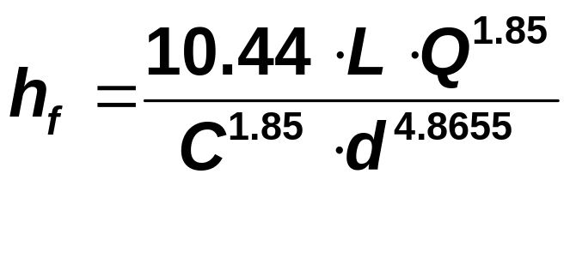
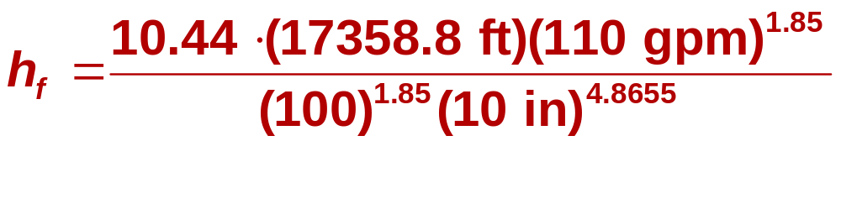
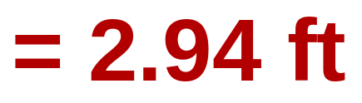
Calculating Head Loss
Hazen-Williams Formula
Notes:
Next, substitute the appropriate values for each of the variable in the Hazen-Williams formula. The total equivalent length should be substituted for L.
[Give students time to copy the formula and make the necessary substitutions.] (click)
[Students should use a calculator to perform the calculation. You may need to walk through the specific calculator function required to apply the exponents and perform the correct division.] (click)
The Hazen-Williams formula is empirical, which means that it is based on experimentation, not on logic or theory. The coefficient of 10.44 and the exponents were determined through experience; therefore, the units will not cancel. However, it is important that you use the correct units for substitution into the formula. Feet for length, gallons per minute for flow rate, and inches for the pipe diameter.

Slide 25
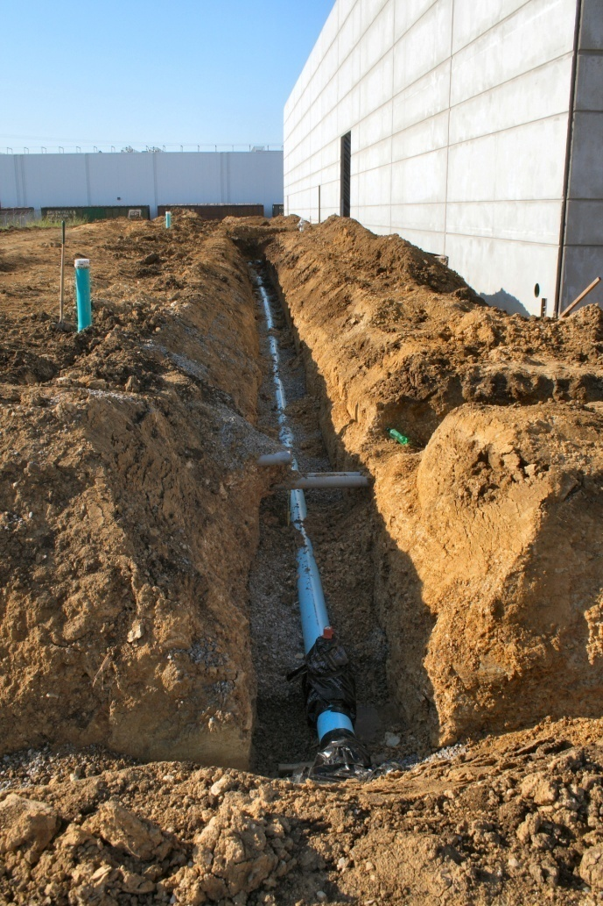
Definition
Dynamic Head
  Head of a moving fluid
  Measured in feet of water
  Dynamic Head = Static Head – Head Loss
Courtesy Constructionphotographs.com

Slide 26
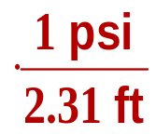
Definition
Dynamic / Actual Pressure
  Measured in psi
  Dynamic Pressure = Actual Pressure
  Actual Pressure = Dynamic Head
Notes:
The terms dynamic pressure and actual pressure are used interchangeably and can be calculated by converting Dynamic Head in feet of water to pounds per square foot.

Slide 27
Water Pressure Calculations
  Example
    The water level in the water tower supplying the home in the previous example is 1487 ft. The elevation of the supply line at the residence is 1246 ft. Find the static head, the static pressure, the dynamic head, and the actual pressure of the water as it enters the residence.
Notes:
Read the example problem. What would you find first?

Slide 28
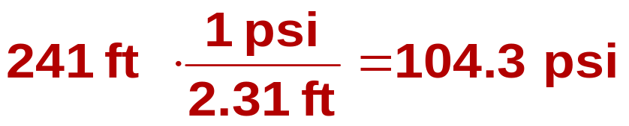
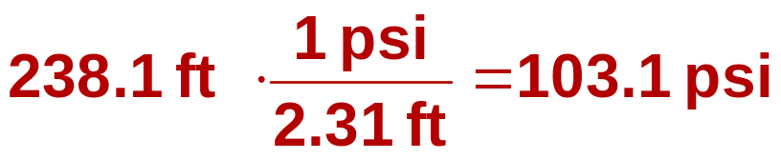
Example
Static Head=
Static Pressure =
Head Loss (major and minor) = 2.94 ft
Dynamic Head = Static Head – Head Loss
Dynamic Pressure =
Notes:
The static head is the difference in elevation between the water level in the tank and the supply line level. [Let students calculate before you show them the calculation.] (click)
The static pressure is simply a conversion of the static head. [Let students calculate before you show them the calculation.] (click)
The head loss was calculated on a previous slide.
The dynamic head is the difference between the static head minus the head loss. [Let students calculate before you show them the calculation.] (click)
The dynamic pressure is the dynamic head converted to psi. [Let students calculate before you show them the calculation.] (click)
Is this pressure acceptable for a residence? No. This pressure is too high. Codes restrict the pressure to 80 psi. A pressure-reducing valve should be installed to reduce the pressure to the residence.

Slide 29
References
Dion, T. (2002). Land development for civil engineers (2nd Ed.). New York: John Wiley & Sons.
Lindeburg, M. (2008). Civil engineering reference manual for the PE exam (11th Ed.). Belmont, CA: Professional Publications, Inc.

Slide 30
Image Sources
USDA at http://www.ks.nrcs.usda.gov/news/highlights/2006_april.html
NASA at http://www.ghcc.msfc.nasa.gov/surface_hydrology/water_management.html
NOAA at http://www.csc.noaa.gov/alternatives/infrastructure.html
www.istock.com
The Groundwater Foundation at www.groundwater.org
USGS at http://pubs.usgs.gov/fs/2004/3069/
EPA at http://www.epa.gov/region02/superfund/npl/mohonkroad/images.html
Wikimedia at http://en.wikipedia.org/wiki/File:Largediapvc.jpg
www.constructionphotographs.com

